Slide 1
DEGs
Run DEG with Limma (microarray) and DESeq2 (RNA-seq)
Took fold change, changed scale to be central to zero
Positive Fold change → 328 genes
Negative fold change → 69 genes

Slide 2
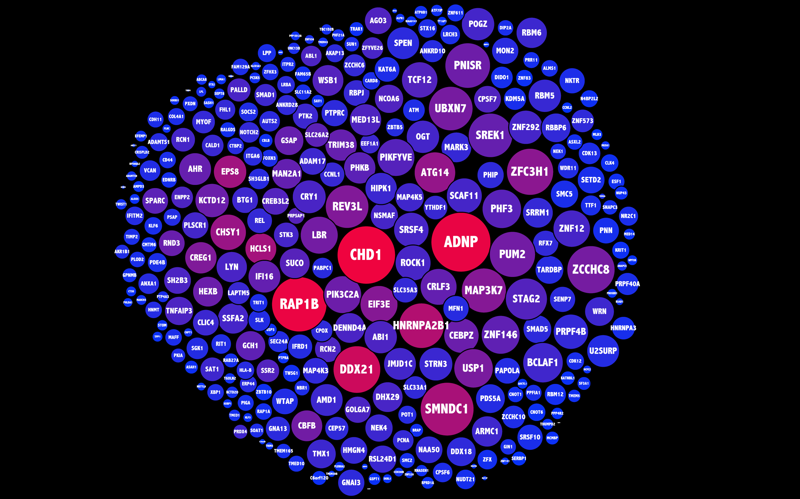
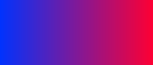
3.864E-5
0.016
Betweeness Centrality
Degree

Slide 3
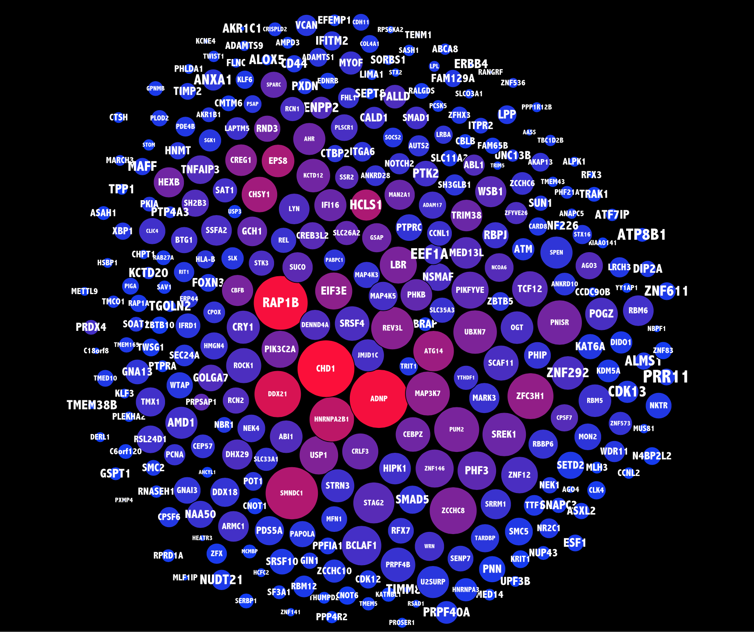
Up Genes
3.864E-5
0.016
Betweeness Centrality
Degree
Variance across patients
Low
High

Slide 4
Up Gene Functional Enrichment
KEGG | Wikipathways | Reactome | GO BP | GO CP | GO MF
mRNA surveillance pathway (0.0035) | mRNA Processing HS (4e-5) | Processing of capped intron-containing pre-mRNA HS (0.03) | mRNA Processing (2.8e-7) | Nucleolus (1.7e-7) | Protein serine/threonine kinase activity (0.03)
 | mRNA Processing MM (9e-5) | mRNA splicing HS (0.03) | RNA splicing (6e-7) | Nucleoplasm (1.7e-6)
 | EGF/EGFR Signaling Pathway HS (2e-4) | mRNA Splicing – Major Pathway HS (0.03) | RNA splicing, via transesterification reactions (1.4e-6) | Nuclear body (2.2e-4)
 | PluriNetWork MM (0.015) | mRNA 3’-end processing HS (0.03) | mRNA splicing, via spliceosome (2.1e-5) | Spliceosomal complex (0.003)
 | TSH signaling pathway HS (0.03) | Post-elongation processing of intron-containing pre-mRNA HS (0.03) | RNA splicing via transesterification reactions with bulged adenosine as nucleophile (2.1e-5) | Catalytic step 2 spliceosome (0.003)
 |  | Gene expression HS (0.04) | RNA 3’-end processing (4.6e-5) | Nuclear speck (0.004)
 |  | RNA Polymerase II Transcription Termination HS (0.04) | mRNA 3’-end processing (5.6e-5) | Cell-substrate adherens junction (0.004)
 |  | Cleavage of growing transcript in the termination region HS (0.04) | Sister chromatid cohesion (0.009) | Cell-substrate junction (0.004)

Slide 5
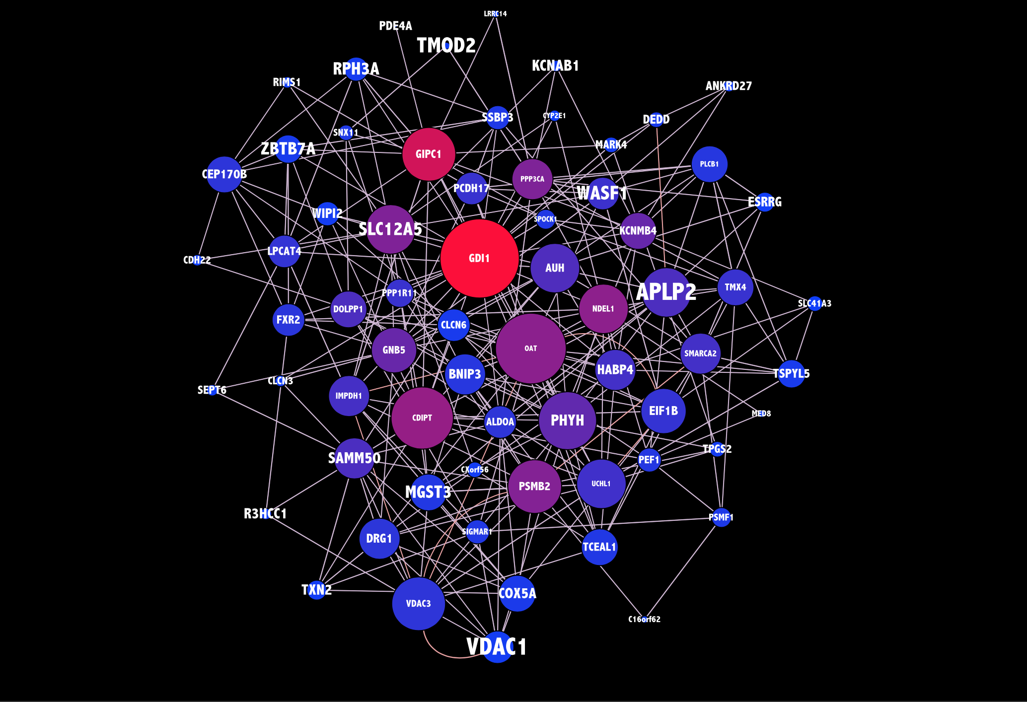
Up Genes
3.864E-5
0.016
Betweeness Centrality
Degree
Variance across patients
Low
High

Slide 6
Down Gene Functional Enrichment
KEGG | Wikipathways | Reactome | GO BP | GO CP | GO MF
cGMP-PKG signaling pathway HS (0.03) | --- | Beta-catenin independent WNT signaling HS (0.03) | Synaptic transmission (0.09) | Mitochondrial outer membrane (0.005) | Voltage-gated anion channel activity (0.0002)
 |  | Opioid Signalling HS (0.03) | Regulation of anion transport (0.09) | Outer membrane (0.005) | Anion channel activity (0.02)
 |  |  |  | Organelle outer membrane (0.005) | Phosphatidylinositol phosphate binding (0.02)
 |  |  |  | Nuclear envelope (0.02) | Voltage-gated ion channel activity (0.02)
 |  |  |  | Envelope (0.02) | Voltage-gated channel activity (0.02)
 |  |  |  | Organelle envelope(0.02) | GTP-ase binding (0.03)
 |  |  |  | Proteasome core complex (0.04) | Phosphatidylinositol biphosphate binding (0.03)
 |  |  |  |  | Voltage-gated chloride channel activity (0.03)

Slide 7
Pathway Analysis
Run Pathprint on each dataset
C9orf72 ALS
FTLD (sporadic and GRN)
Sporadic ALS
Multisystem proteinopathy (VCP)
Split patients and controls
Run consensus on each
Take pathways with differing consensus
Split into up (pat > con) and down (pat < con)

Slide 8
Upregulated pathways
Pathway | Notes on role
{BRCA1,28} (Static Module) | DNA damage response/Fanconi anaemia
{F2,46} (Static Module) | Complement and coagulation/Immune system
{FCGR2B,50} (Static Module) | Complement and coagulation/Immune system
{RB1,11} (Static Module) | Cell Cycle
{VCP,17} (Static Module) | Protein processing in endoplasmic reticulum
ABC transporters (KEGG) | Membrane transport
Alanine, aspartate and glutamate metabolism (KEGG) | Amino acid metabolism
Aminoacyl-tRNA biosynthesis (KEGG) | Translation
Basal transcription factors (KEGG) | Trancription
Codeine and morphine metabolism (Wikipathways) | Drug metabolism
Endometrial cancer (KEGG) | Cancer/DNA damage response/Fibroblast growth factor signalling
Fat digestion and absorption (KEGG) | Lipid metabolism
Fatty Acid Biosynthesis (Wikipathways) | Fatty acid metabolism
Glutathione metabolism (KEGG) | Amino acid metabolism
Glycine, serine and threonine metabolism (KEGG) | Amino acid metabolism
Id Signaling Pathway (Wikipathways) | Transcription
IL-2 down reg. targets (Netpath) | Immune system
Metabolic pathways (KEGG) | (no longer exists)
Mitochondrial LC-Fatty Acid Beta-Oxidation (Wikipathways) | Fatty acid metabolism
Muscle contraction (Reactome) | Circulatory system
Phagosome (KEGG) | Transport/Immune system
Vitamin B12 Metabolism (Wikipathways) | Vitamin metabolism
Vitamin D synthesis (Wikipathways) | Vitamin metabolism

Slide 9
Downregulated pathways
Pathway | Notes on role
{ABL1,15} (Static Module) | Cytoskeleton/Axon guidance
{ACY1,11} (Static Module) | Protein metabolism
{ARRB2,743} (Static Module) | Olfactory transduction
{CHRNA1,13} (Static Module) | Cholinergic receptors
{DVL1L1,17} (Static Module) | WNT signalling pathway
{HRAS,27} (Static Module) | Signal transduction
{TCF3,20} (Static Module) | Myogenesis
Aflatoxin B1 metabolism (Wikipathways) | Xenobiotic metabolism/mycotoxin metabolism
Alzheimer's disease (KEGG) | Electron transport chain
Blood Clotting Cascade (Wikipathways) | Damage repair response
Collecting duct acid secretion (KEGG) | Excretory system/transferrin transport
Diabetes pathways (Reactome) | Diabetes
Estrogen signaling pathway (Wikipathways) | Signalling
Glucocorticoid & Mineralcorticoid Metabolism (Wikipathways) | Adrenal cortex
Influenza A (KEGG) | Immune system
Phototransduction (KEGG) | Signalling
Serotonin Receptor 4/6/7 and NR3C Signaling (Wikipathways) | Signalling
Signaling by GPCR (Reactome) | Signalling
Signaling by Insulin receptor (Reactome) | Signalling
SNARE interactions in vesicular transport (KEGG) | Folding, sorting and degradation
Statin Pathway (Wikipathways) | Lipid metabolism
Striated Muscle Contraction (Wikipathways) | Muscle contraction
Tyrosine metabolism (KEGG) | Amino acid metabolism
Urea cycle and metabolism of amino groups (Wikipathways) | Amino acid metabolism

Slide 10
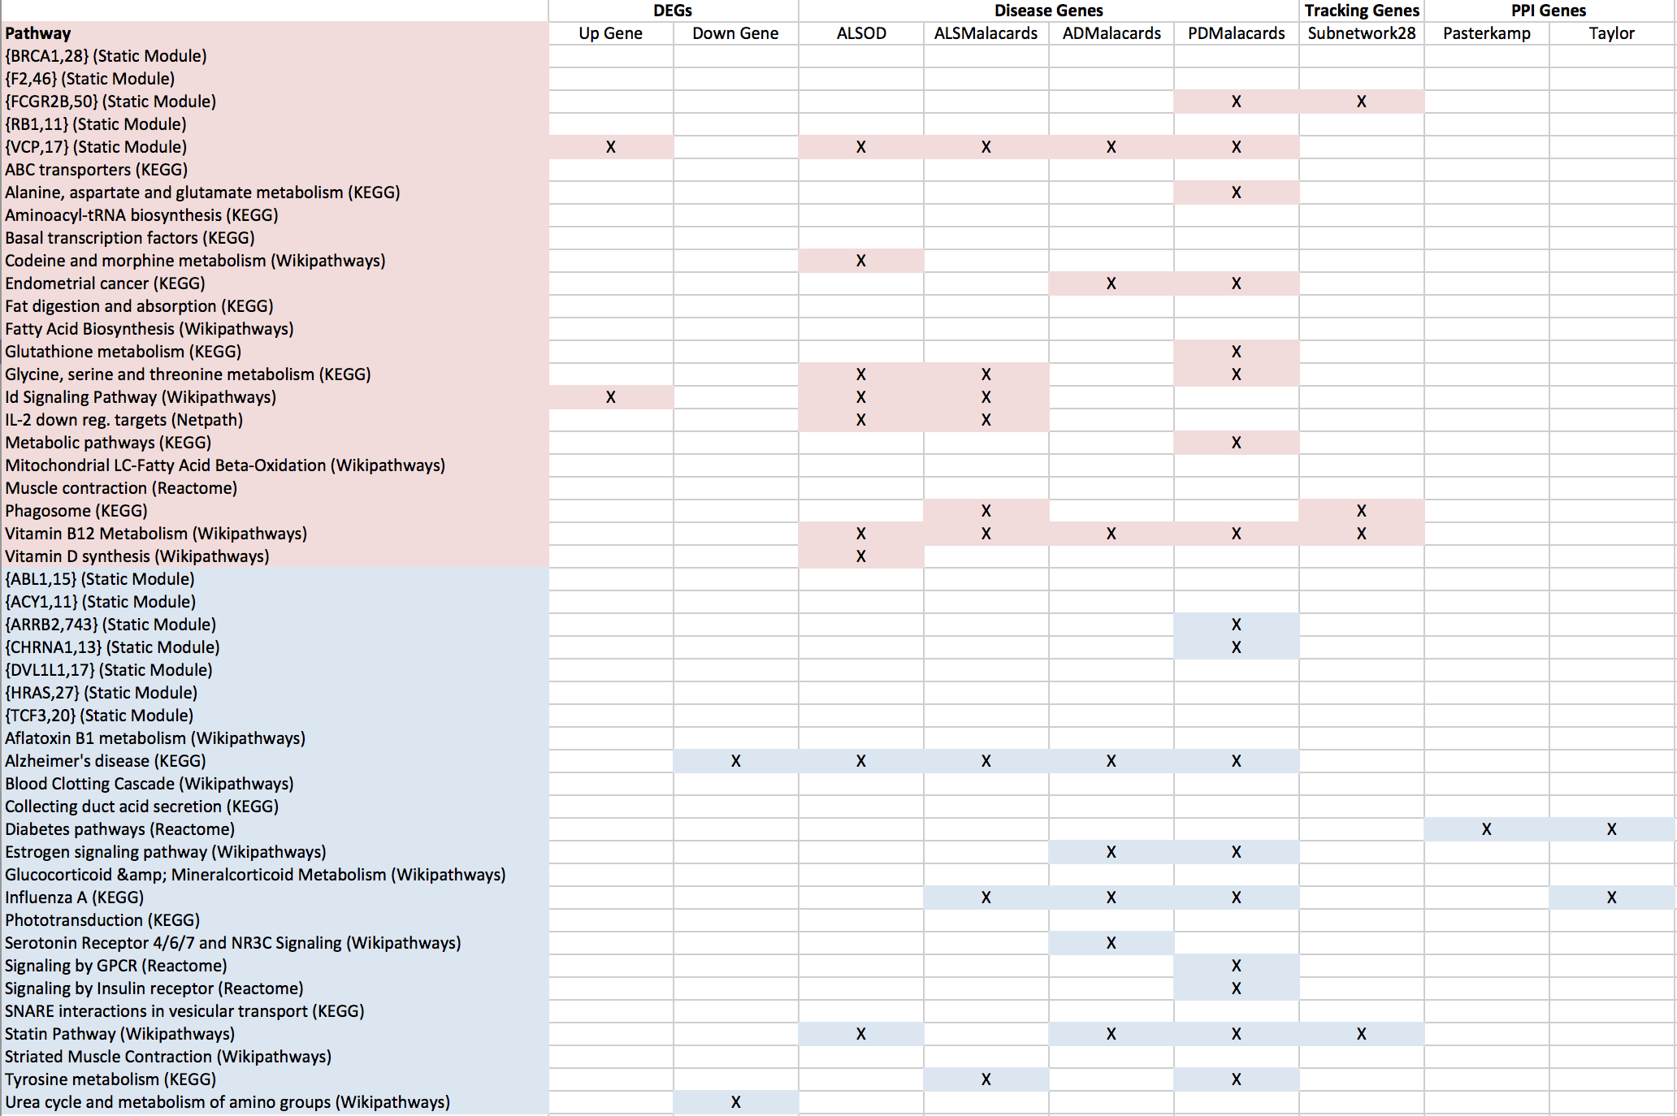
Pathway Enrichment

Slide 11
Purifying the TDP-43 signal
Up gene/pathway
Down gene/pathway
TDP+ ND vs. TDP- ND
Up in non-TDP ALS
N up
N Down
Down in non-TDP ALS
ND signal
ND signal
TDP+ ALS vs. TDP+ non-ALS
Large variance
Small variance
Small variance
Large variance
ALS signal
ALS signal

Slide 12
Non-TDP Pathway Analysis
This might change…
3 SOD1 patients, 7 control (LCM motor neuron)
3 FUS patients, 3 control (LCM motor neuron)
Same methodology – combine patients, combine controls, run consensus fingerprint, find differences

Slide 13
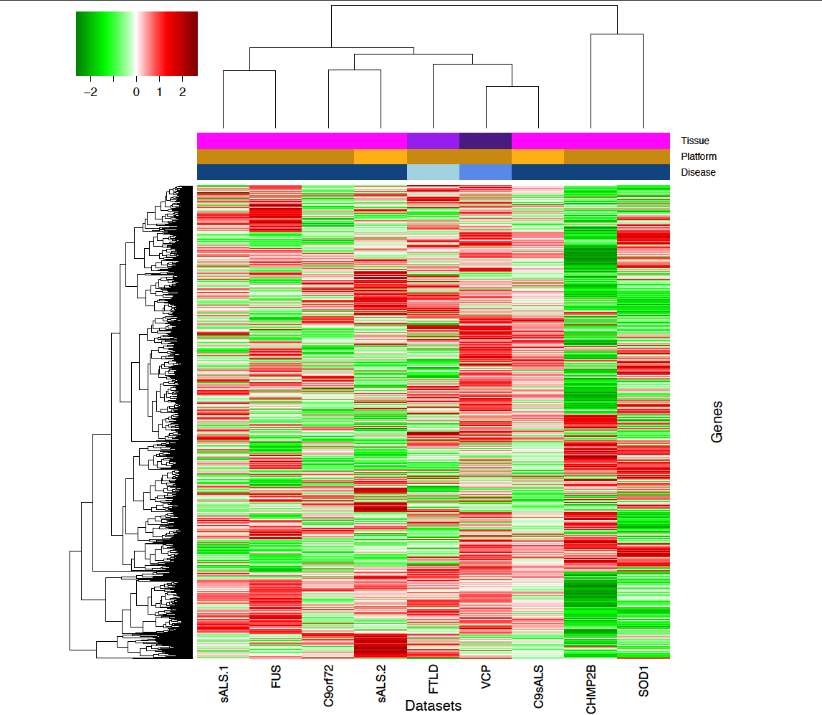
Gene Heat Map (log2 FC)

Slide 14
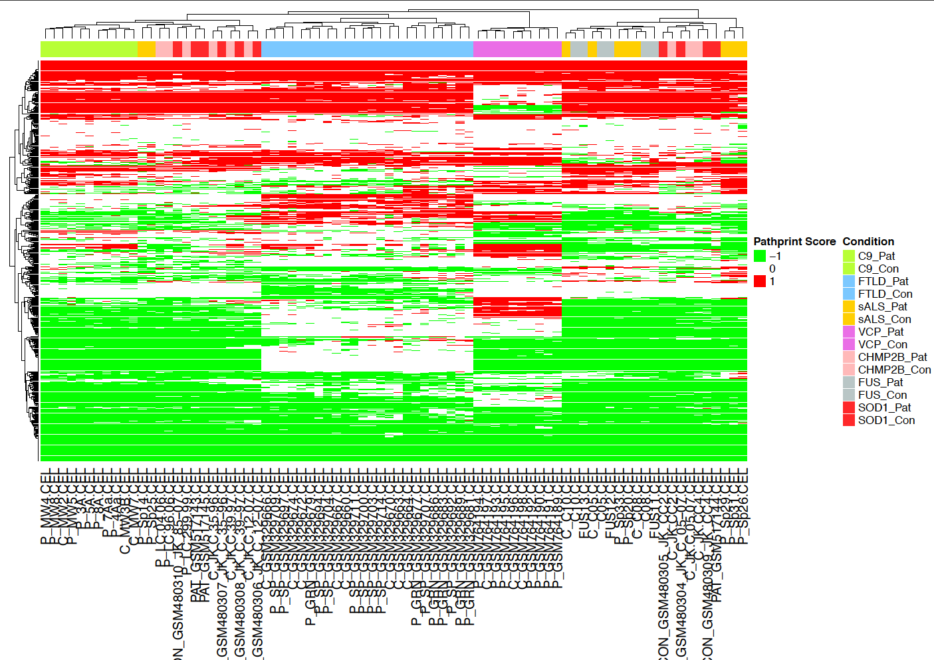
Pathway Heat Map (Pathprint)

Slide 15
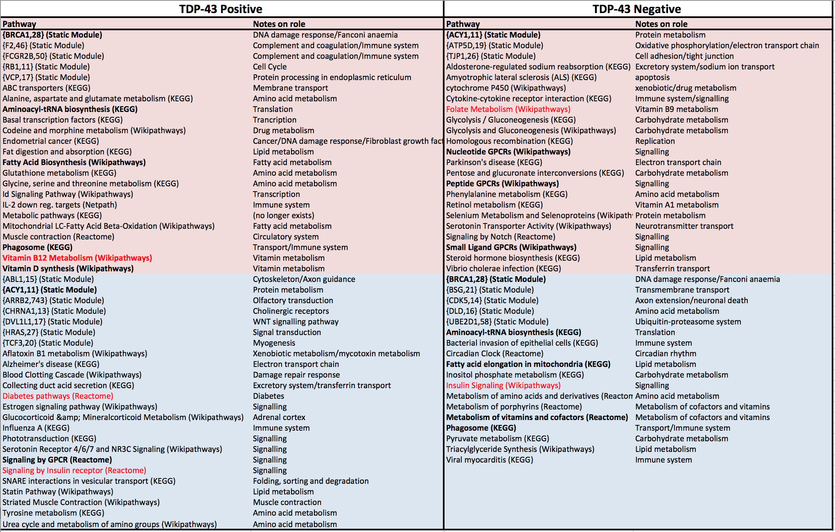
Differential pathway comparison

Slide 16
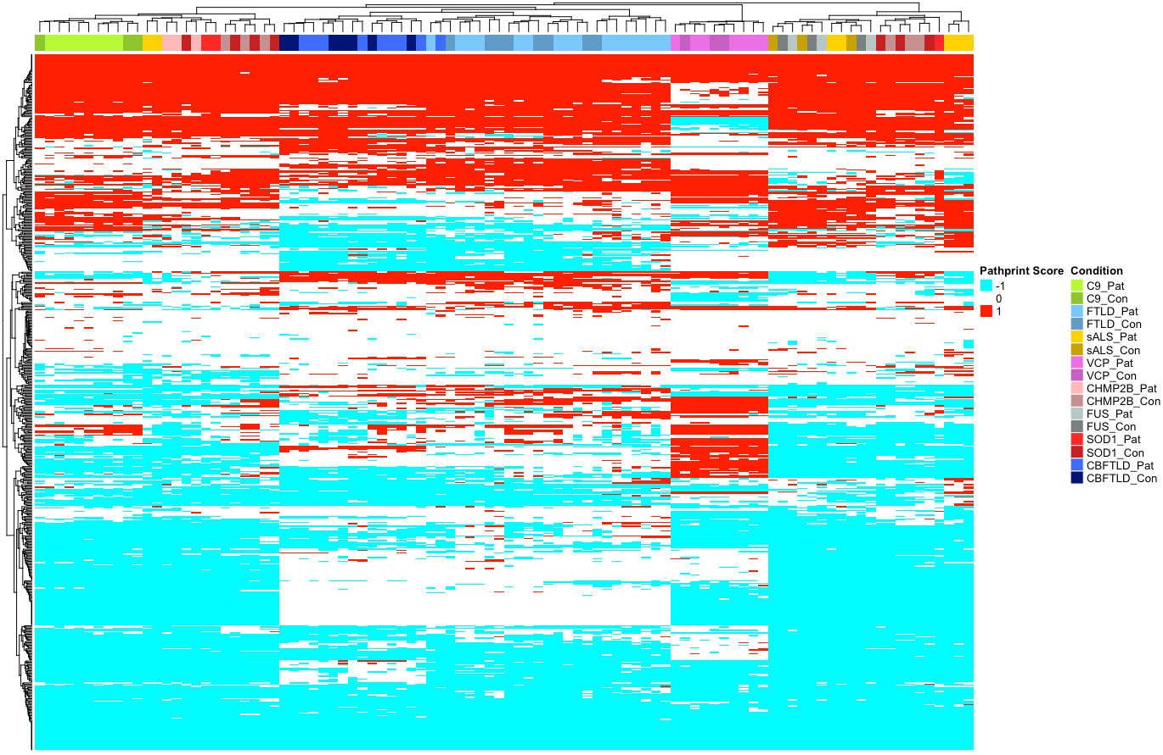
FTLD Cerebellum

Slide 17
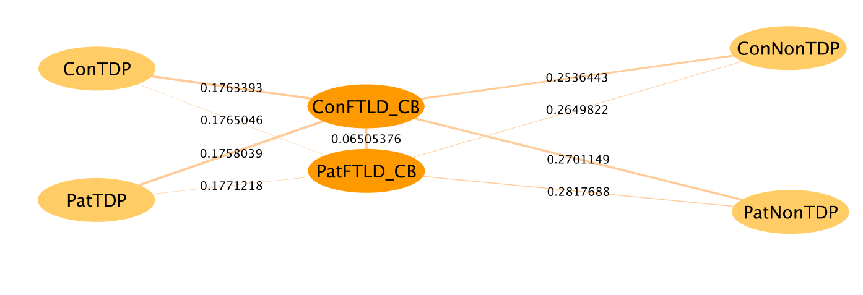
FTLD Cerebellum

Slide 18
Non-TDP Gene Analysis
3 SOD1 patients, 7 control (LCM motor neuron)
3 FUS patients, 3 control (LCM motor neuron)
Same methodology – separate upregulated and downregulated genes. Find consensus.

Slide 19
TDP- vs TDP+
328 genes
69 genes
15 genes
2059 genes
1089 genes
97 genes

Slide 20
TDP- vs TDP+
After removal of common genes, functional enrichment becomes less significant
KEGG | Wikipathways | Reactome | GO BP | GO CP | GO MF
mRNA surveillance pathway (0.09) (0.0035) | mRNA Processing MM (1.8e-4) (9e-5) | Nothing below 0.2 | RNA splicing, via transesterification reactions (7.4e-5) (1.4e-6) | Nucleolus (1.7e-6) (1.7e-7) | Nothing below 0.1
 | EGF/EGFR Signaling Pathway HS (1.3e-3) (2e-4) |  | mRNA Processing (1.5e-4) (2.8e-7) | Nucleoplasm (0.005) (1.7e-6)
 | mRNA Processing HS (1.3e-3) (4e-5) |  | RNA splicing (1.5e-4) (6e-7) | Cell-substrate adherens junction (0.01) (0.004)
 | PluriNetWork MM (0.08) (0.015) |  | mRNA splicing, via spliceosome (5e-4) (2.1e-5) | Lysosome (0.01)
 | TSH signaling pathway HS (NS) (0.03) |  | RNA splicing via transesterification reactions with bulged adenosine as nucleophile (5e-4) (2.1e-5) | Lytic vacuole (0.01)
 |  |  | Regulation of vasculature development (0.02) | Spliceosomal complex (0.01) (0.003)

Slide 21
Pathprint Analysis
Consensus vs mean
Consensus
Mean threshold set at 0.5 for +1 and -0.5 for -1
Mean
-1
0
1
Downregulated
Upregulated
-1
0
1
Downregulated
Upregulated

Slide 22
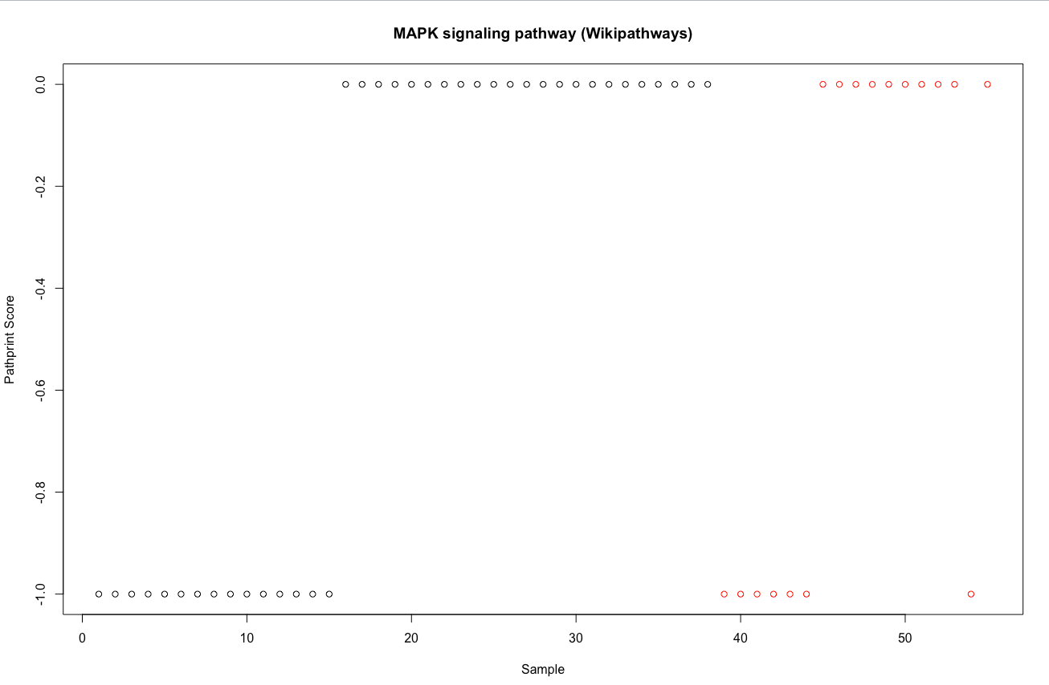
Different consensus, small difference in mean
Consensus
0 -1
Mean
-0.39 -0.41

Slide 23
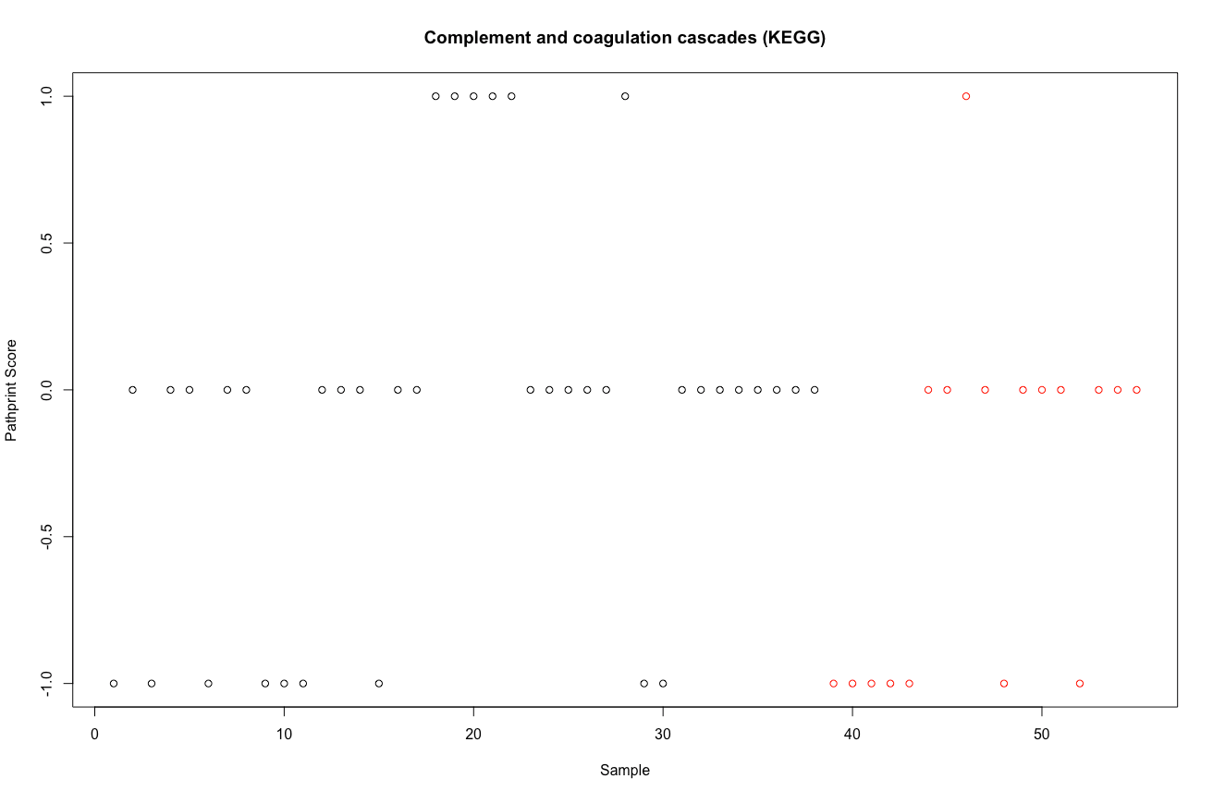
Big difference in mean, same consensus
Consensus
0 0
Mean
-0.08 -0.35

Slide 24
Different consensus, large difference in mean
Consensus
0 -1
Mean
-0.31 -0.76

Slide 25
Use both….
Run consensus on patients and controls with threshold of 0.4 + -0.4
Select out pathways whose mean difference is less than 0.1
Running this by Gabriel…

Slide 26
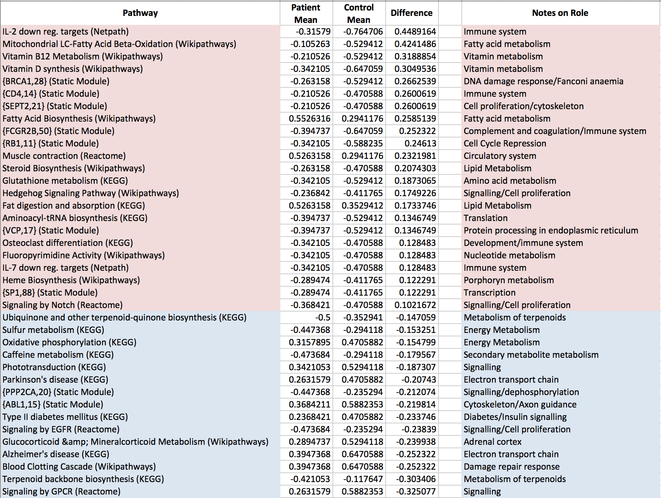

Slide 27
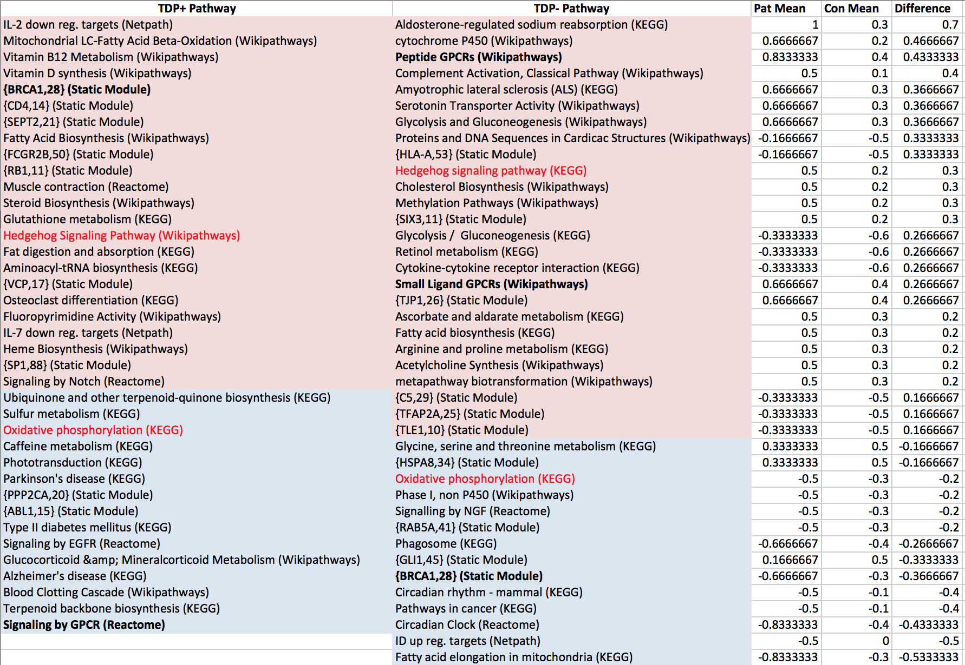

Slide 28
Genes as classifier
Cerebellum FTLD – to include or not to include?
Leaning towards not – but possible validation dataset?
FTLD CB biases
Patient (some samples same patient as frontal cortex
Batch
Platform
Disease
If you can classify FTLD CB with non-TDP datasets…

Slide 29
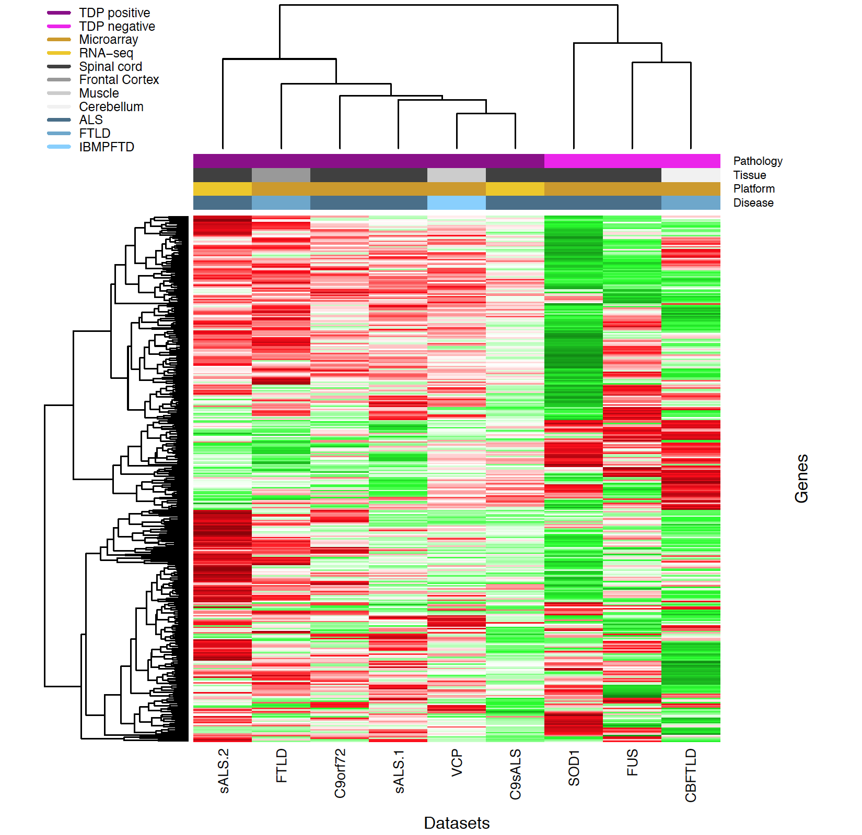
Before filtering:
328 commonly upregulated
69 commonly downregulated genes

Slide 30
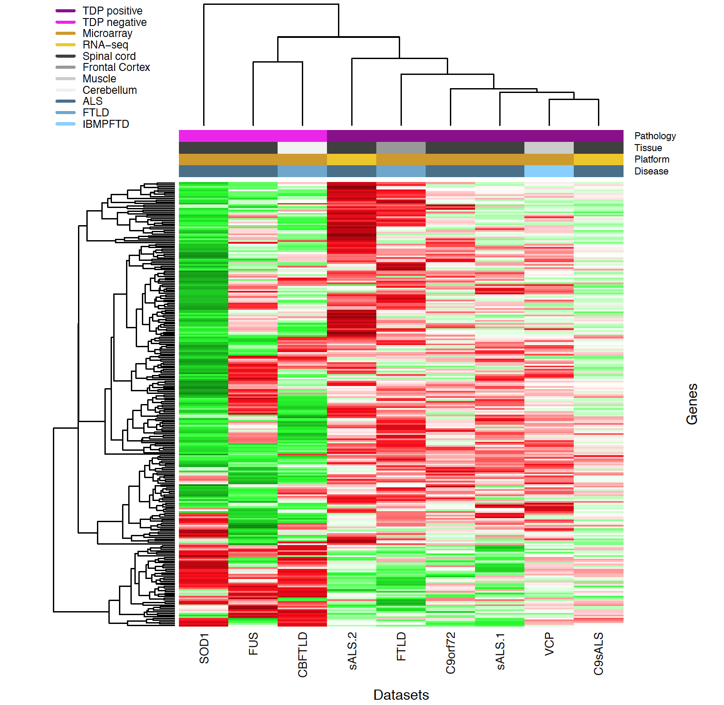
After filtering genes common to SOD1 and FUS datasets:
231 commonly upregulated
69 commonly downregulated genes

